Slide 1
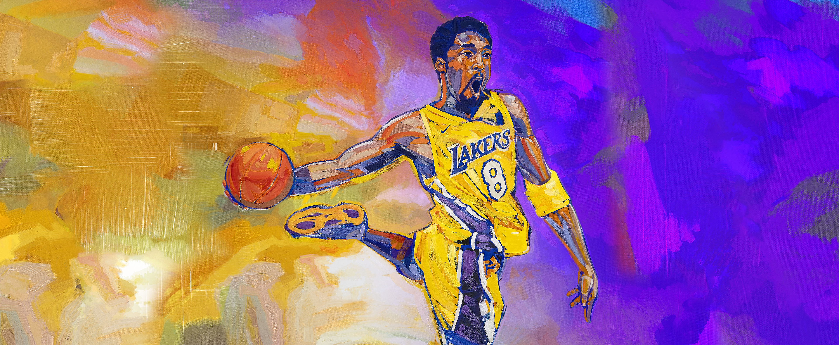

Predicting NBA Positions from Player stats

Slide 2
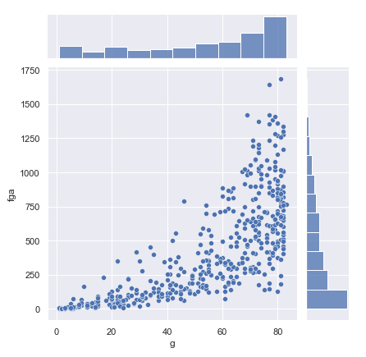
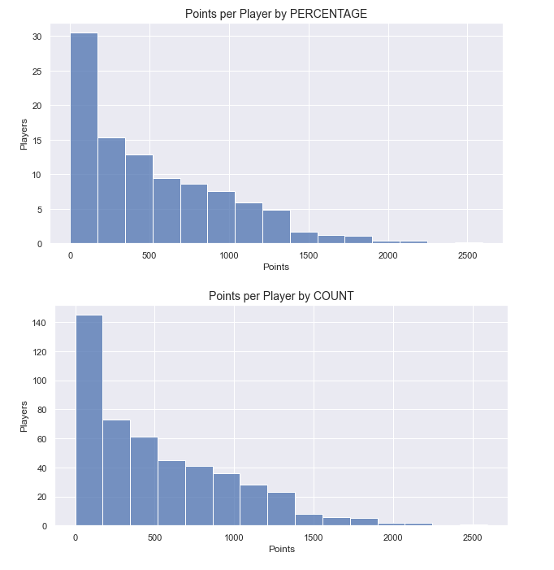
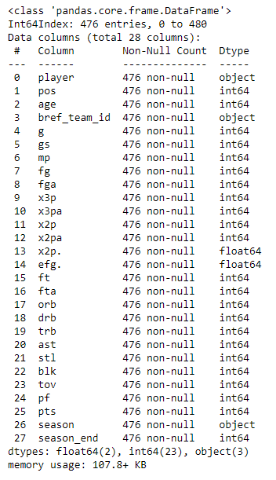
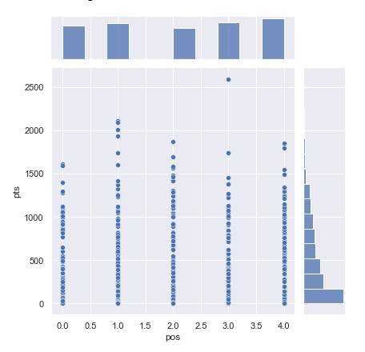
EDA and Visualization

Slide 3
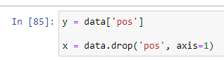
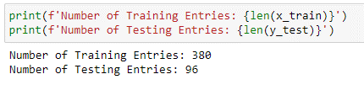
Splitting The Data

Slide 4

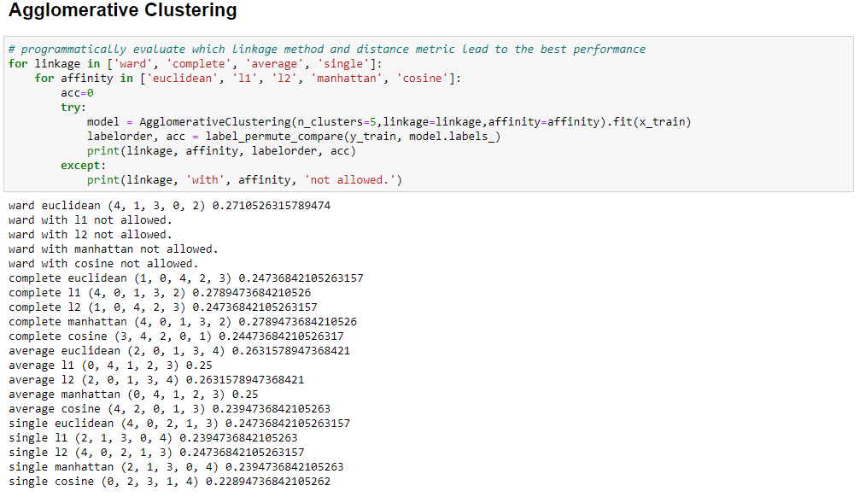
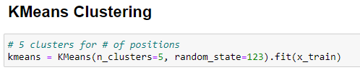
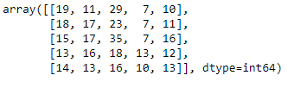
Unsupervised Models

Slide 5

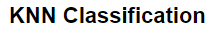
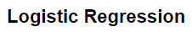
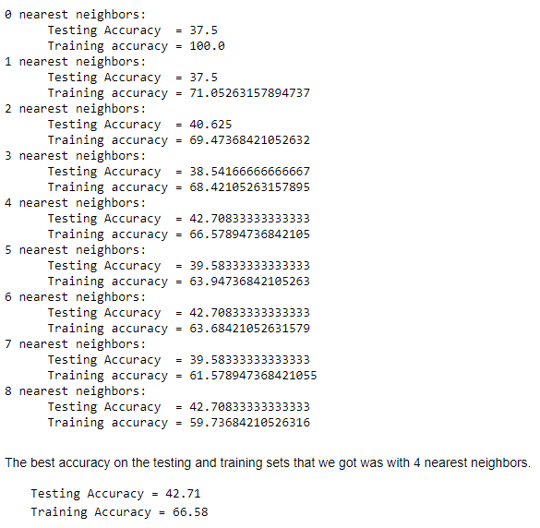
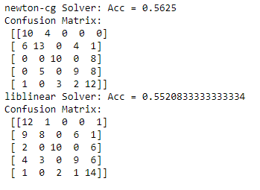
Supervised Models

Slide 6

Analysis and Conclusion
So, it looks like our data is not a great fit for unsupervised learning. This could be many different reasons, not enough samples (only had 478) or it could be that the stats between the positions is not unique enough for the algorithms to draw clear distinctions between them, meaning that it was hard to cluster them with their position accurately.
Comparing them to Supervised models, the Supervised models performed much better, which makes sense. The positions are not different enough for the algorithm to cluster them, but when the players are labeled, the algorithm can find the patterns better.

